Slide 1
ALGORITHMS ASSIGNMENT 3
Drup Acharya 2022CSB071
Shruti Kumari Singh 2022CSB097
Umashankar 2022CSB099

Slide 2
Github Links :
Please find all codes and files used in the presentation using this link :
https://github.com/Drup2021/AlgorithmsLab/tree/main/Assignment3

Slide 3
1. Implement Kruskal's algorithm and Prim's algorithm for minimum spanning tree problem using conventional data structures for graph and test for correctness using small examples.
2. We need to scale up the things - from toy problems to real life problems. For this, you need to study some large datasets provided by reputed Universities, like
(a) SNAP - Stanford Network Analysis Project - datasets collected by Stanford University.
(b) KONECT - Koblenz Network Collection - datasets compiled by Koblenz University, Deutschland (Germany).
First study and feel the vastness of these networks from the dynamic and disjoint set operations point of view. Then try to implement graph algorithms like Connected Components and Minimum Spanning Tree using appropriate data structure for these datasets.

Slide 4
1. Implement Kruskal's algorithm and Prim's algorithm for minimum spanning tree problem using conventional data structures for graph and test for correctness using small examples.

Slide 5
Minimum Spanning Tree and Connected Components :
A Minimum Spanning Tree (MST) or minimum weight spanning tree is a subset of the edges of a connected, edge-weighted undirected graph that connects all the vertices together, without any cycles and with the minimum possible total edge weight. It is a spanning tree whose sum of edge weights is as small as possible.
A Connected Component of an undirected graph is a connected subgraph that is not part of any larger connected subgraph. The components of any graph partition its vertices into disjoint sets, and are the induced subgraphs of those sets. A graph that is itself connected has exactly one component, consisting of the whole graph.

Slide 6
Steps of Kruskal’s Algorithm:
Sort all the edges in non-decreasing order of their weight.
Pick the smallest edge. Check if it forms a cycle with the spanning tree formed so far. If the cycle is not formed, include this edge. Else, discard it.
Repeat step#2 until there are (V-1) edges in the spanning tree.
Kruskal’s algorithm to find the minimum cost spanning tree uses the greedy approach. The Greedy Choice is to pick the smallest weight edge that does not cause a cycle in the MST constructed so far.

Slide 7
Time Complexity for Kruskal’s Algorithm :
Time Complexity: O(E * logE) or O(E * logV)
Sorting of edges takes O(E * logE) time.
After sorting, we iterate through all edges and apply the find-union algorithm. The find and union operations can take at most O(logV) time.
So overall complexity is O(E * logE + E * logV) time.
The value of E can be at most O(V2), so O(logV) and O(logE) are the same. Therefore, the overall time complexity is O(E * logE) or O(E*logV)

Slide 8
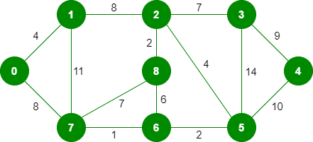
An Example to find Minimum Spanning Tree (MST) : Kruskal’s Algorithm
This is a weighted undirected graph :

Slide 9
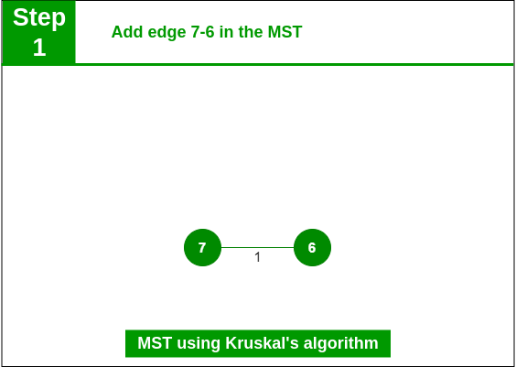
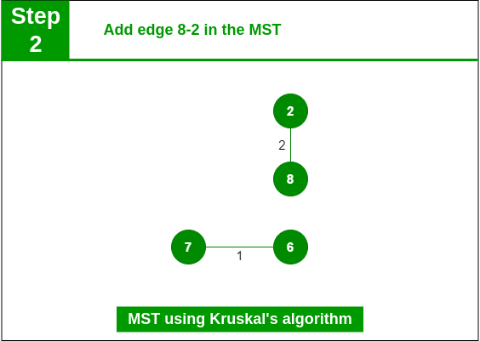
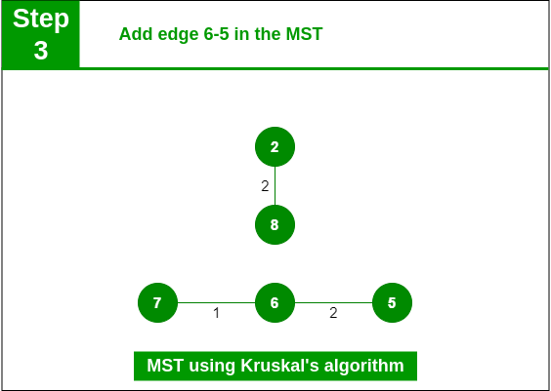
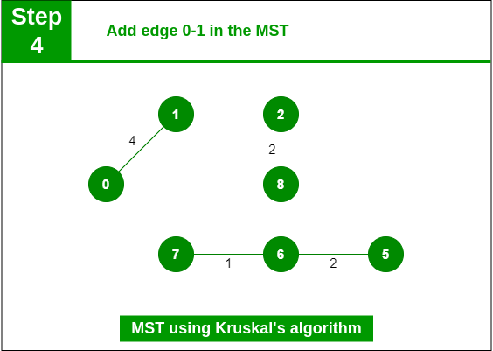
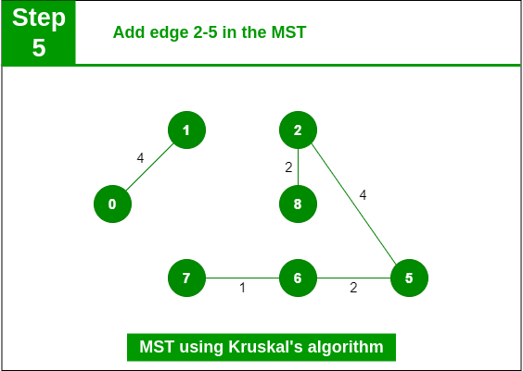
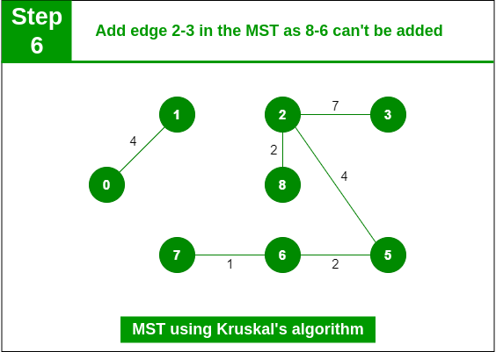
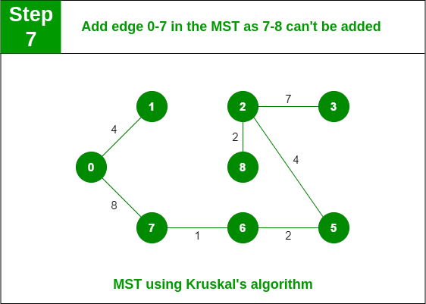
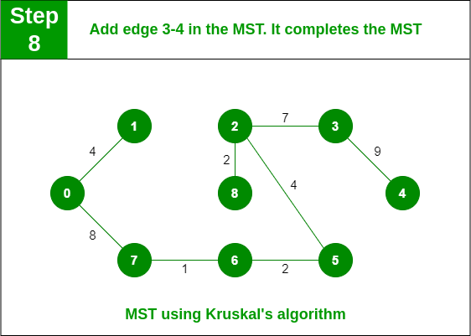

Slide 10
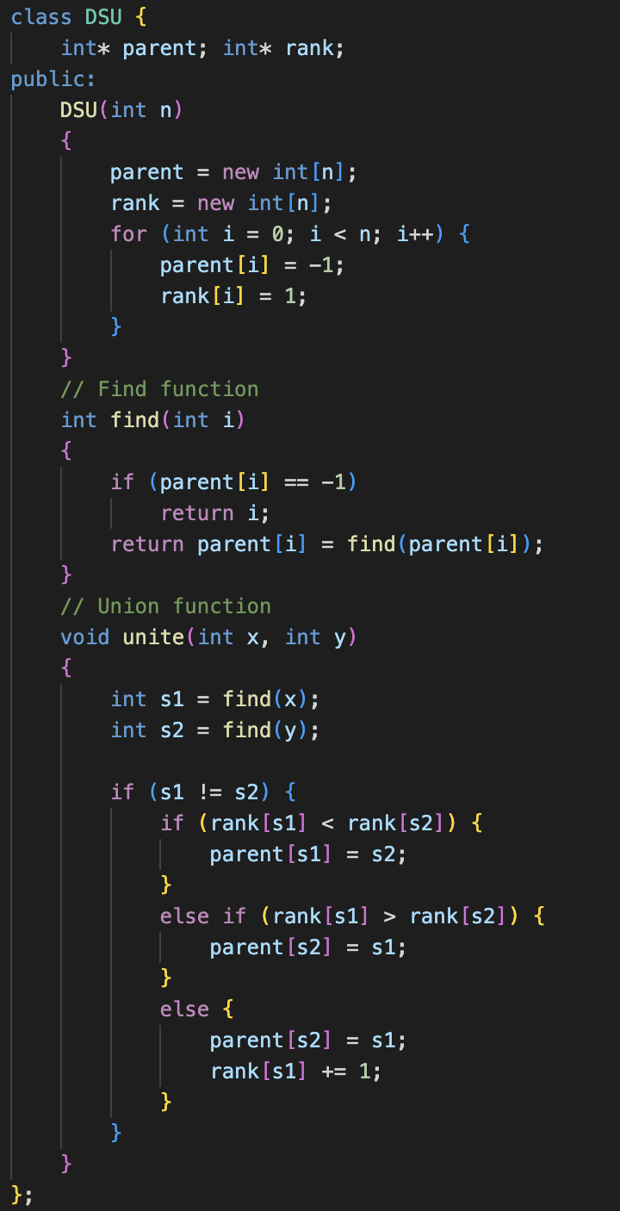
Disjoint Set Union Class :
The class DSU encapsulates the Disjoint Set data structure.
The constructor DSU(int n) initializes the DSU with n elements. It allocates memory for the parent and rank arrays and initializes them.
The find(int i) function returns the root of the set to which element i belongs. It utilizes path compression optimization to flatten the structure of the tree.
The unite(int x, int y) function merges the sets containing elements x and y. It uses union by rank optimization to keep the height of the resulting tree small.

Slide 11
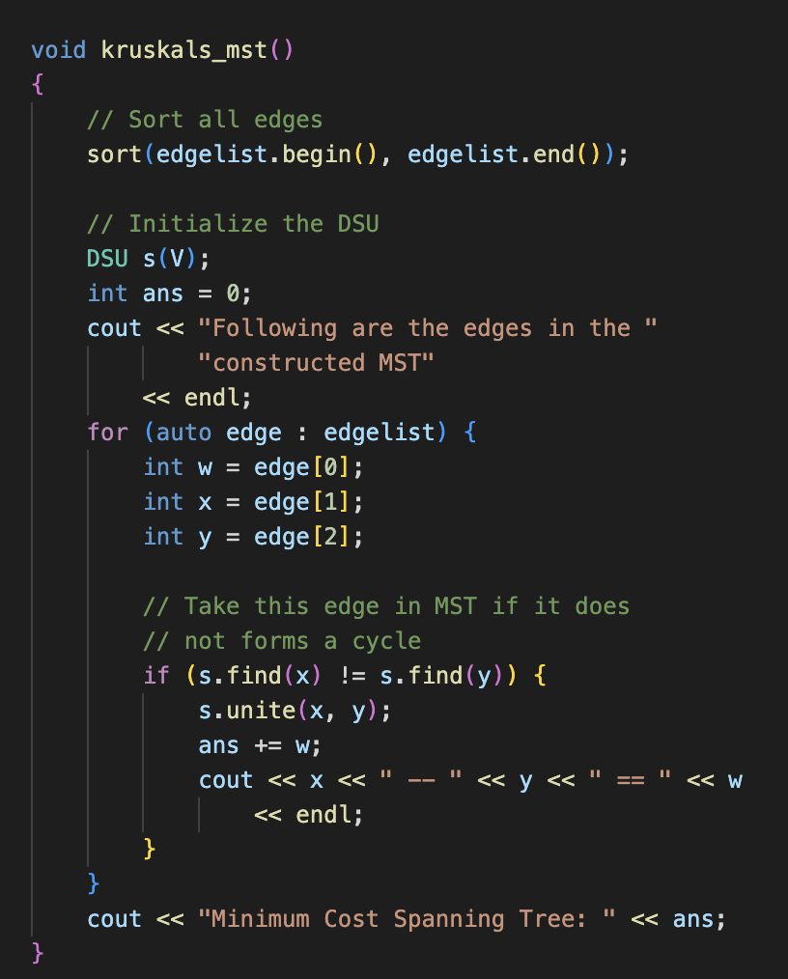
Kruskal’s Algorithm :
The function first sorts all edges in edgelist in non-decreasing order of their weights.
It then initializes a DSU data structure s with V vertices, where V is the total number of vertices in the graph.
It iterates through each edge in the sorted list of edges.
For each edge, it checks if adding the edge to the MST would create a cycle or not. If adding the edge doesn't create a cycle (i.e., the vertices of the edge are not already in the same set), it adds the edge to the MST and updates the total weight ans.
Finally, it prints the edges included in the MST along with their weights and prints the total weight of the Minimum Spanning Tree.

Slide 12
Prim’s Algorithm:
Prim’s algorithm always starts with a single node and moves through several adjacent nodes, in order to explore all of the connected edges along the way.
The algorithm starts with an empty spanning tree. The idea is to maintain two sets of vertices. The first set contains the vertices already included in the MST, and the other set contains the vertices not yet included. At every step, it considers all the edges that connect the two sets and picks the minimum weight edge from these edges. After picking the edge, it moves the other endpoint of the edge to the set containing MST.
A group of edges that connects two sets of vertices in a graph is called cut in graph theory. So, at every step of Prim’s algorithm, find a cut, pick the minimum weight edge from the cut, and include this vertex in MST Set (the set that contains already included vertices).

Slide 13
Steps of Prim’s Algorithm:
Step 1: Determine an arbitrary vertex as the starting vertex of the MST.
Step 2: Follow steps 3 to 5 till there are vertices that are not included in the MST (known as fringe vertex).
Step 3: Find edges connecting any tree vertex with the fringe vertices.
Step 4: Find the minimum among these edges.
Step 5: Add the chosen edge to the MST if it does not form any cycle.
Step 6: Return the MST and exit

Slide 14
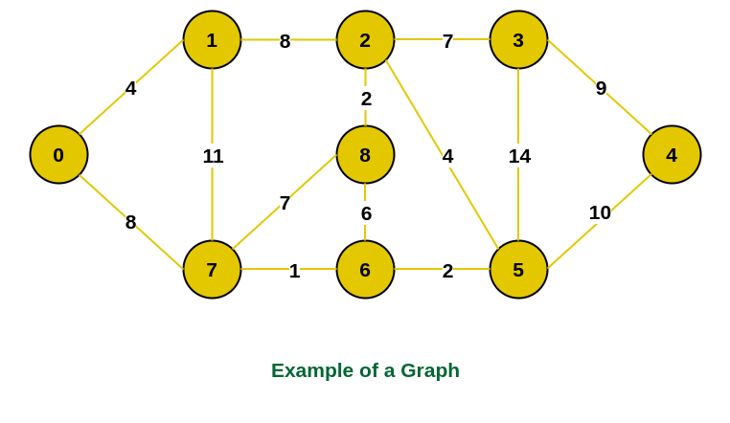
An Example to find Minimum Spanning Tree (MST) : Prim’s Algorithm
This is a weighted undirected graph :

Slide 15
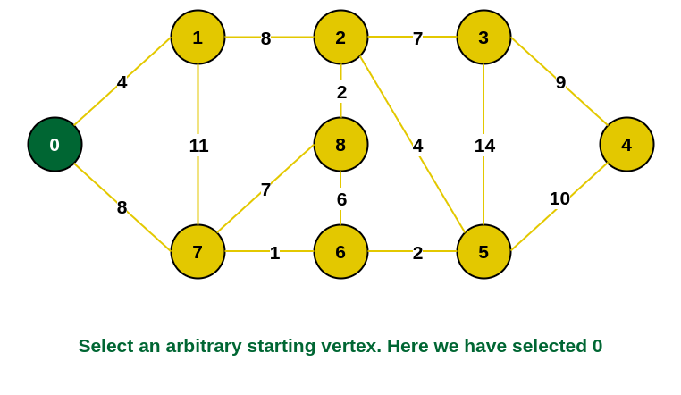
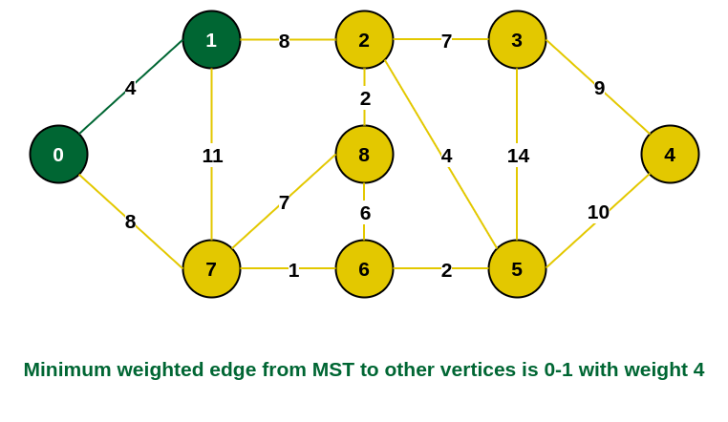
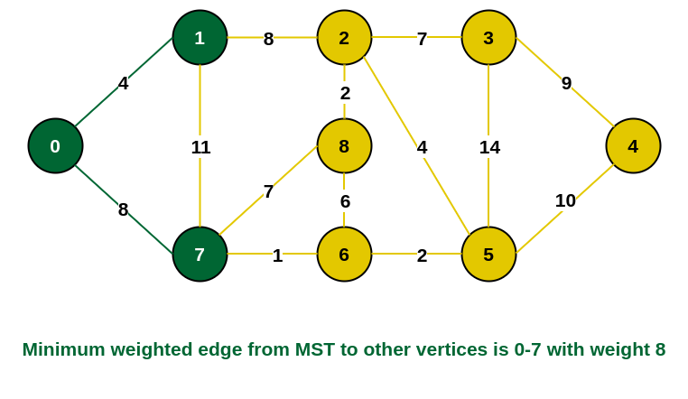
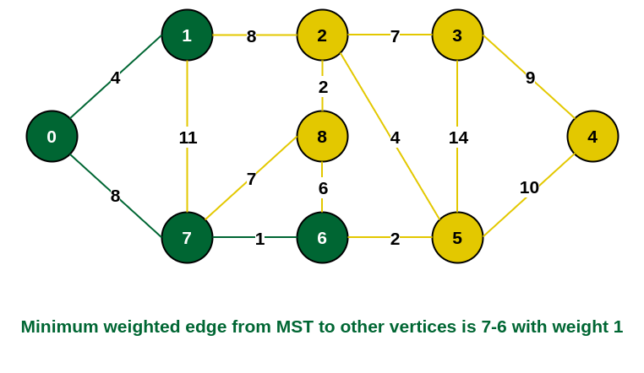
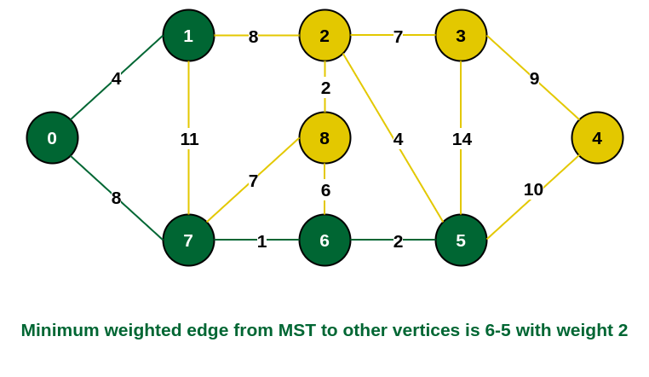
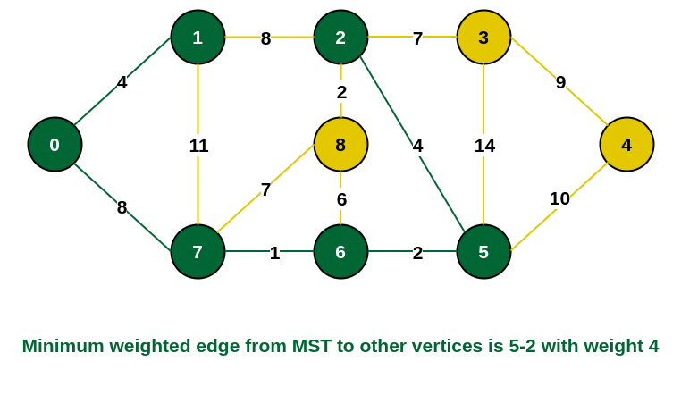
STEP 1
STEP 2
STEP 3
STEP 4
STEP 5
STEP 6

Slide 16
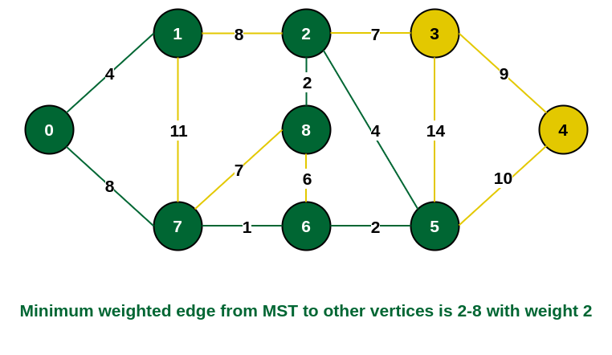
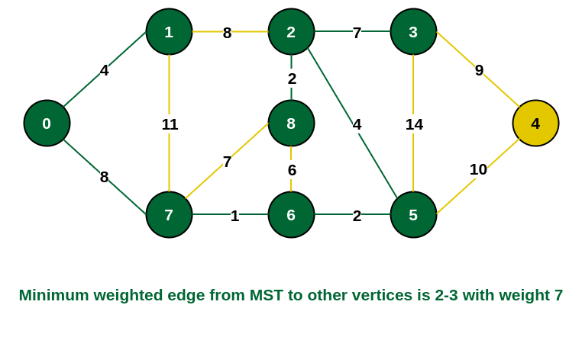
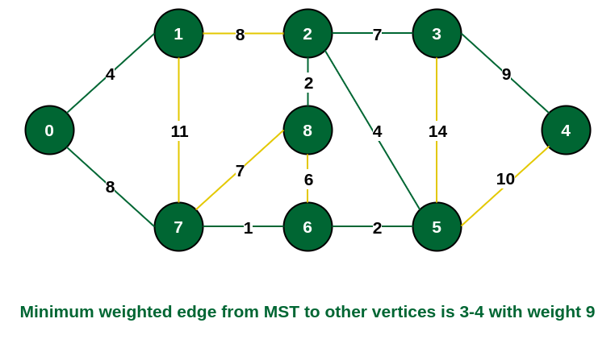
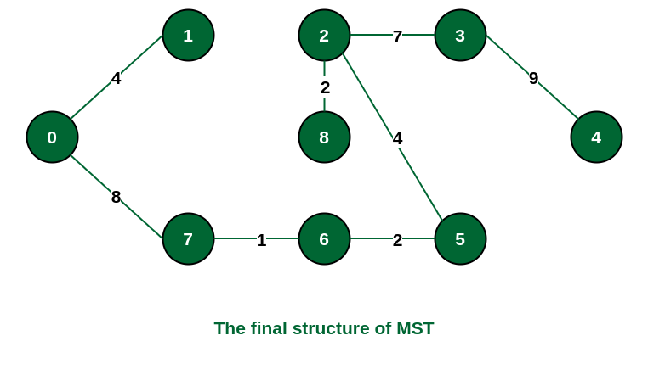
STEP 7
STEP 8
STEP 9
The structure of the MST formed using the above method

Slide 17
Time Complexity of Prim’s Algorithm:
O(V2), If the input graph is represented using an adjacency list, then the time complexity of Prim’s algorithm can be reduced to O(E * logV) with the help of a binary heap. In this implementation, we are always considering the spanning tree to start from the root of the graph

Slide 18
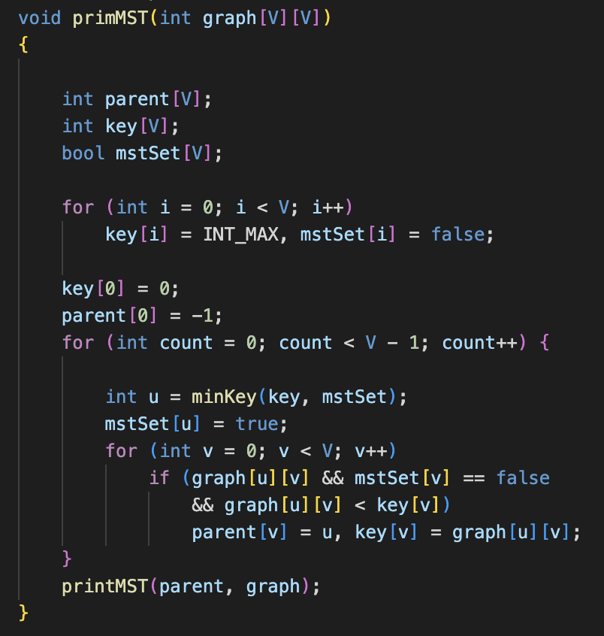
Prim’s Algorithm :
parent[]: This array is used to store the constructed MST. Each element parent[i] represents the parent node of vertex i in the MST.
key[]: This array holds the key values used to pick the minimum weight edge in a cut. Initially, all key values are initialized to INT_MAX, except for the first vertex which is initialized to 0.
mstSet[]: This boolean array represents the set of vertices not yet included in the MST. Initially, all values are set to false.
The outer loop runs V - 1 times because an MST with V vertices will have V - 1 edges.
minKey(): This function finds the vertex with the minimum key value from the set of vertices not yet included in the MST.
The inner loop updates the key values and parent indices of the adjacent vertices of the picked vertex (u), considering only those vertices which are not yet included in the MST.

Slide 19
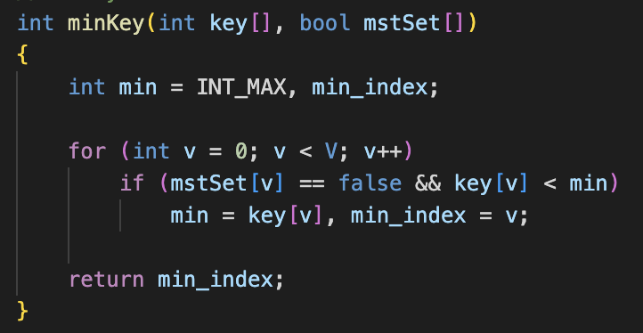
Prim’s Algorithm :
This function minKey is used to find the vertex with the minimum key value from the set of vertices not yet included in the MST (Minimum Spanning Tree).
The function iterates through each vertex in the graph.For each vertex that is not yet included in the MST (mstSet[v] == false), it checks if its key value (key[v]) is smaller than the current minimum (min).
If the key value of the current vertex is smaller, it updates min to this key value and updates min_index to the index of this vertex.
After iterating through all vertices, the function returns the index of the vertex with the minimum key value.

Slide 20
2. Study and Implement graph graph algorithms like Connected Components and Minimum Spanning Tree using appropriate data structure for the datasets from SNAP and KONECT.

Slide 21
About the datasets :
We have utilized the following datasets to test our graph algorithms :
Stanford Network Analysis Dataset(SNAP) :
ego-facebook
Soc-sign-bitcoin-alpha
The KONECT Project :
Les Misérables
Windsurfers

Slide 22
DSU Tree Implementation :
Each node in this implementation has two additional pieces of information besides its value: rank and parent pointer.
The rank of a node indicates the size of the subtree with that node as the root, while the parent pointer points to one of the parent nodes, ideally the highest node in the tree (the main root).

Slide 23
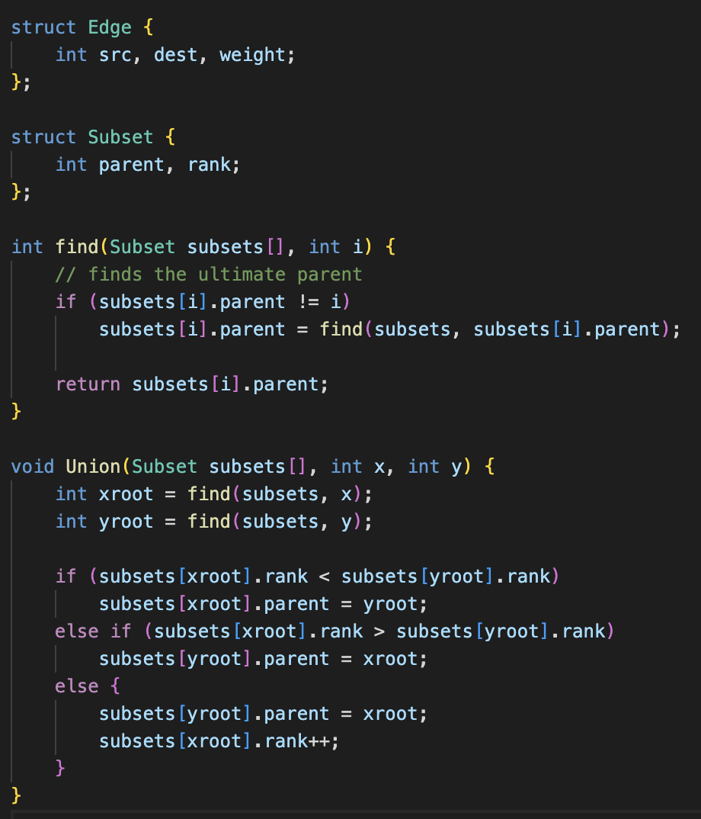
DSU Tree Implementation :
find(Subset subsets[], int i): This function is used to find the ultimate parent of the subset to which element i belongs. It employs path compression, where during the recursive call, it updates the parent of each visited node to the ultimate parent, thus reducing the time complexity for future calls.
Union(Subset subsets[], int x, int y): This function is used to merge two subsets into a single subset. It first finds the ultimate parent of both elements x and y. If the ranks of the subsets (i.e., the height of the trees) are different, it merges the smaller rank tree into the larger rank tree. If the ranks are the same, one tree is arbitrarily chosen to be the parent, and its rank is incremented.

Slide 24

Ego-facebook dataset :
Dataset statistics :
Nodes : 4039
Edges : 88234
Unweighted graph; so unit weights have been assigned to the edges.
We applied Kruskal’s and Prim’s algorithm to it and the results are displayed.
For the output MST, Click Here

Slide 25

Soc-sign-bitcoin-alpha dataset :
Dataset Statistics :
Nodes : 3783
Edges : 24186
Range of edge weights : -10 - +10
However, for this experiment, we have considered the negative weights as positive by taking its modulus.
We applied Kruskal’s and Prim’s algorithm to it and the results are displayed.
For the output MST, Click Here

Slide 26

Les Misérables dataset :
Dataset Statistics :
Nodes : 77
Edges : 254
Node meaning : character
Edge meaning : Co-occurrence
We applied Kruskal’s and Prim’s algorithm to it and the results are displayed.
For the output MST, Click Here

Slide 27

Windsurfers dataset :
Dataset Statistics :
Nodes : 43
Edges : 336
Node meaning : Person
Edge meaning : Contact
We applied Kruskal’s and Prim’s algorithm to it and the results are displayed.
For the output MST, Click Here

Slide 28
Thank You

